Slide 1


Tour De Grocer
2023
300 KM CYCLE OF IRELAND
THE MAIN SPONSOR OF THIS EVENT IS BARILLA

Slide 2
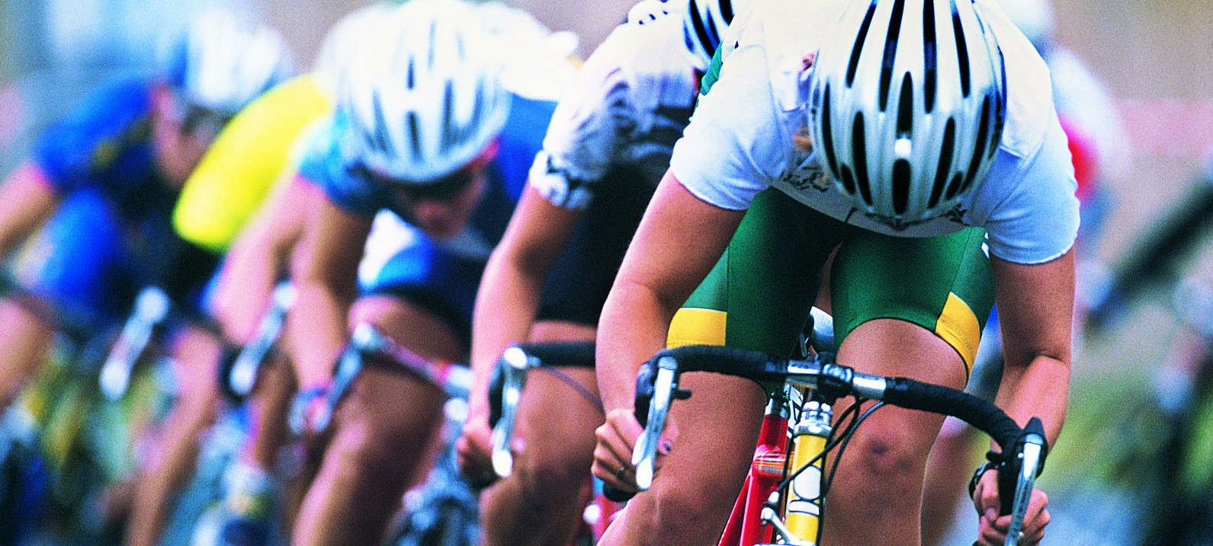



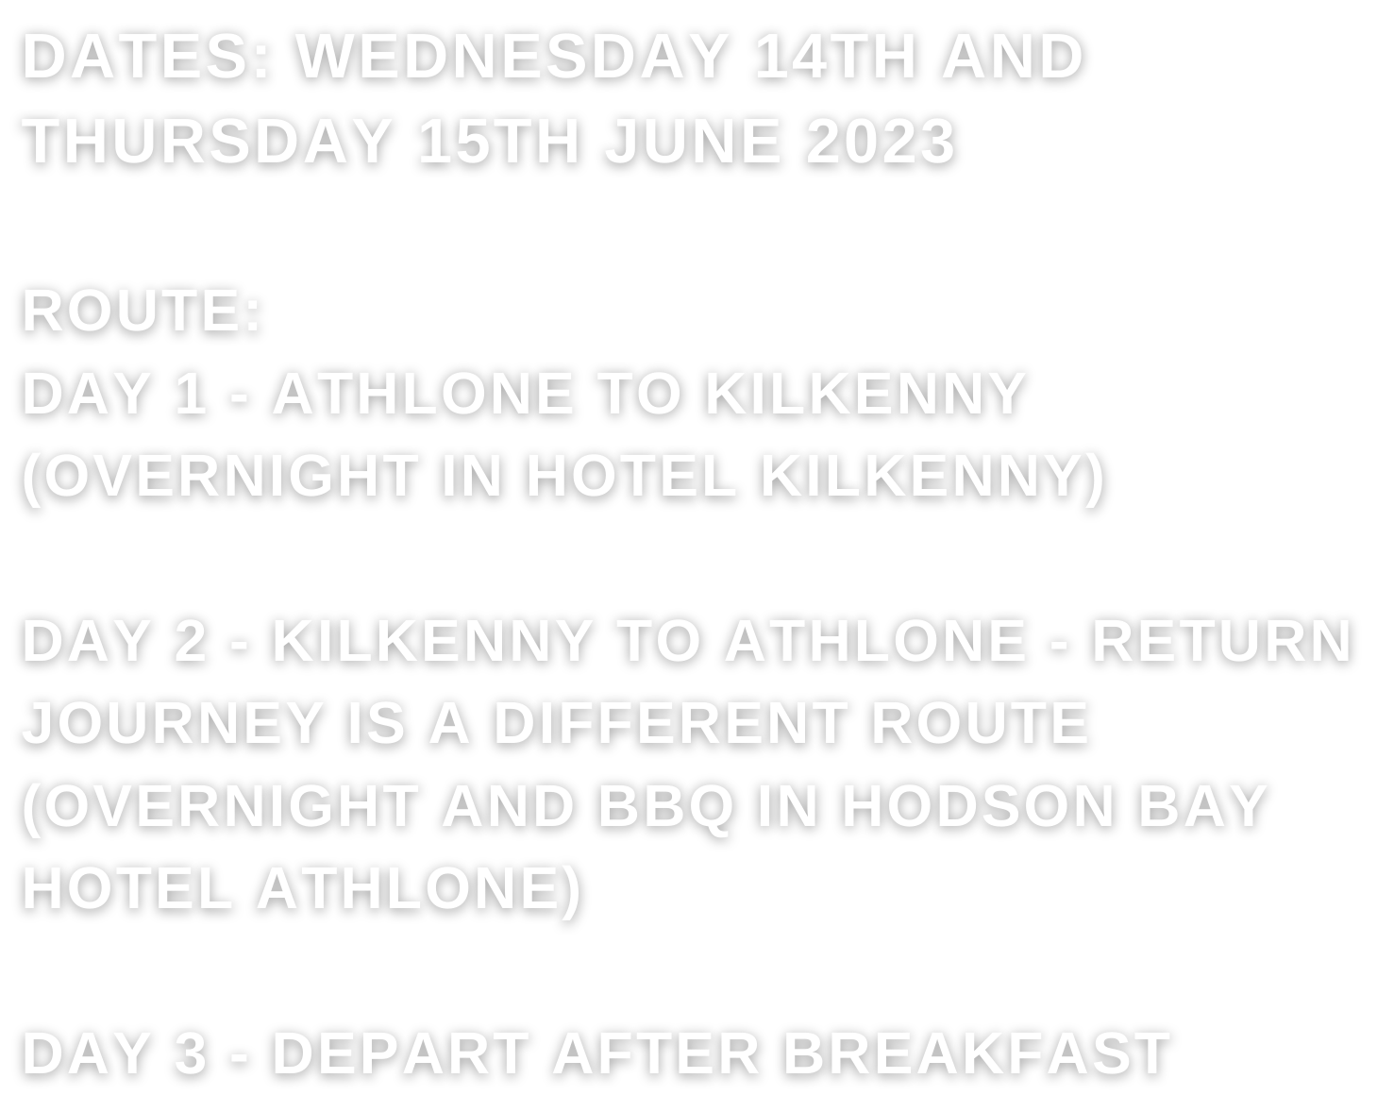
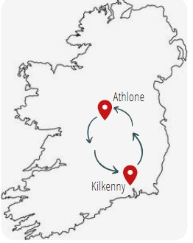



When and Where

Slide 3

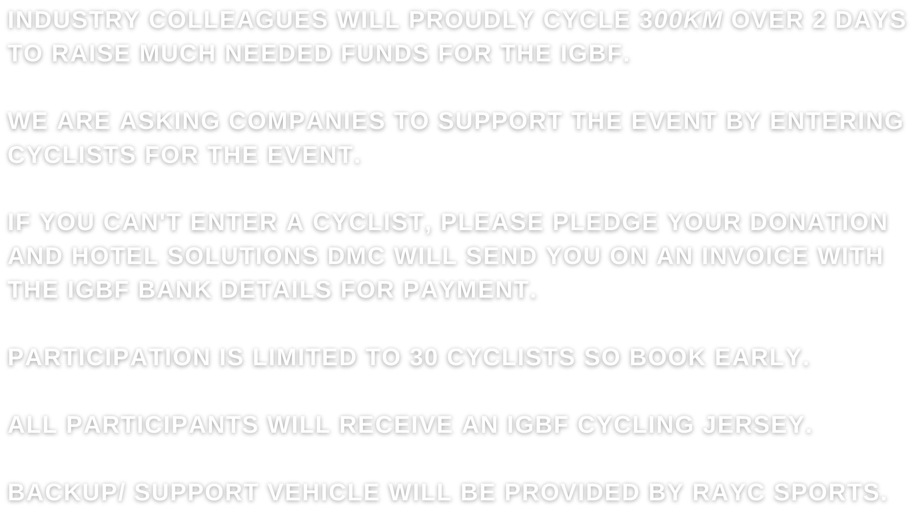


How will the cycle work ?

Slide 4
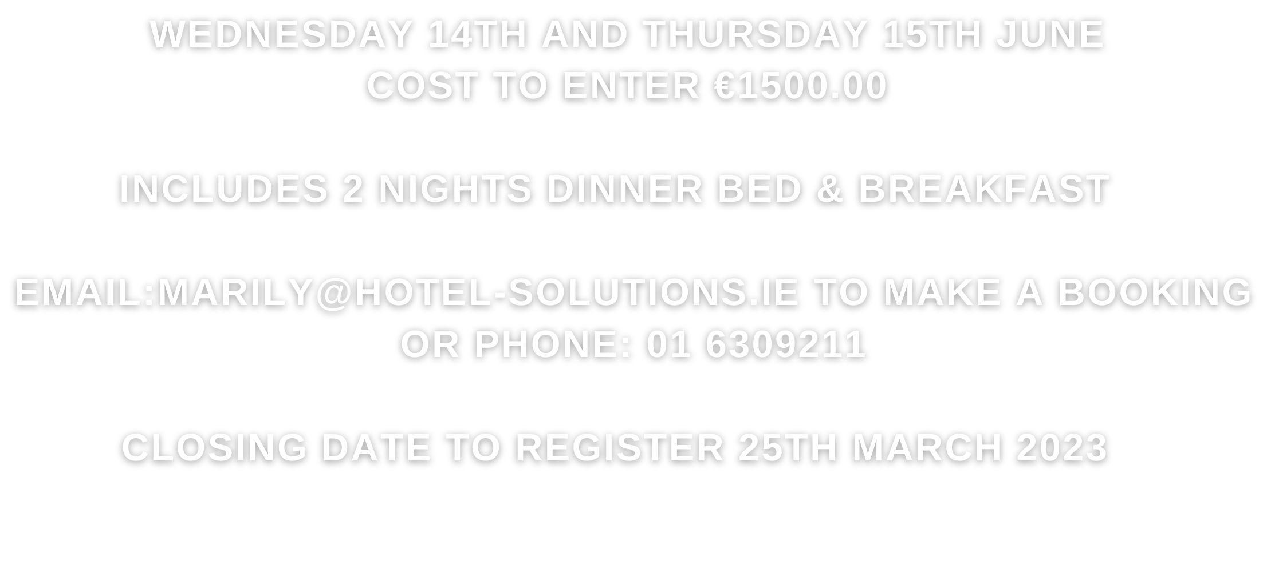



Cost to participate

